Slide 1
Naïve Bayes

Slide 2
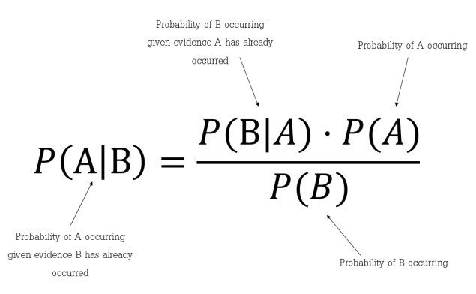
Introduction
Naive Bayes classifiers are a collection of classification algorithms based on Bayes’ Theorem. It is not a single algorithm but a family of algorithms where all of them share a common principle, i.e. every pair of features being classified is independent of each other.
Naïve Bayes is a probabilistic machine learning algorithm based on the Bayes Theorem, used in a wide variety of classification tasks
Bayes Theorem
Bayes’ Theorem is a simple mathematical formula used for calculating conditional probabilities.
Conditional probability is a measure of the probability of an event occurring given that another event has (by assumption, presumption, assertion, or evidence) occurred.
where A and B are events and P(B) ≠ 0.
Basically, we are trying to find probability of event A, given the event B is true. Event B is also termed as evidence.
P(A) is the priori of A (the prior probability, i.e. Probability of event before evidence is seen). The evidence is an attribute value of an unknown instance(here, it is event B).
P(A|B) is a posteriori probability of B, i.e. probability of event after evidence is seen.

Slide 3
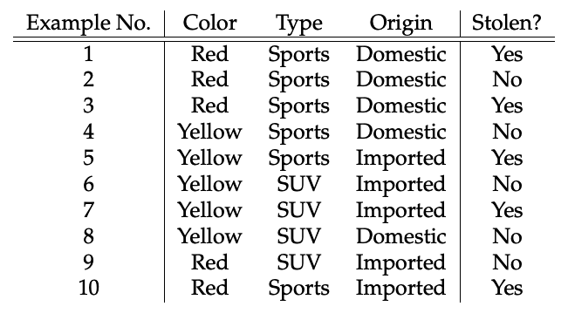
Naïve Bayes Example
Concerning our dataset, the concept of assumptions made by the algorithm can be understood as:
We assume that no pair of features are dependent. For example, the color being ‘Red’ has nothing to do with the Type or the Origin of the car. Hence, the features are assumed to be Independent.
Secondly, each feature is given the same influence(or importance). For example, knowing the only Color and Type alone can’t predict the outcome perfectly. So none of the attributes are irrelevant and assumed to be contributing Equally to the outcome.
Here in our dataset, we need to classify whether the car is stolen, given the features of the car. The columns represent these features and the rows represent individual entries. If we take the first row of the dataset, we can observe that the car is stolen if the Color is Red, the Type is Sports and Origin is Domestic.
So we want to classify a Red Domestic SUV is getting stolen or not. Note that there is no example of a Red Domestic SUV in our data set.

Slide 4
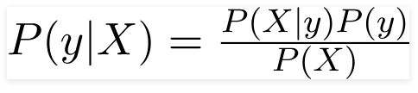

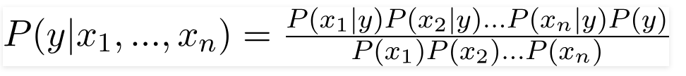

Naïve Bayes Example
According to this example, Bayes theorem can be rewritten as:
The variable y is the class variable(stolen?), which represents if the car is stolen or not given the conditions. Variable X represents the parameters/features.
X is given as,
Here x1, x2…, xn represent the features, i.e they can be mapped to Color, Type, and Origin. By substituting for X and expanding using the chain rule we get
Now, you can obtain the values for each by looking at the dataset and substitute them into the equation. For all entries in the dataset, the denominator does not change, it remains static. Therefore, the denominator can be removed, and proportionality can be injected.

Slide 5

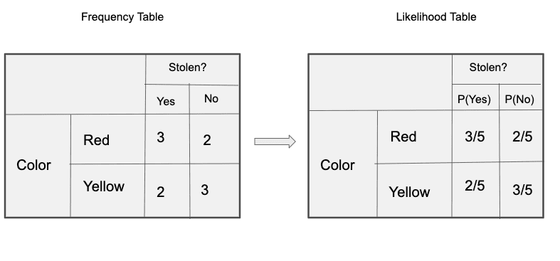
In our case, the class variable(y) has only two outcomes, yes or no. There could be cases where the classification could be multivariate. Therefore, we have to find the class variable(y) with maximum probability.
Using the above function, we can obtain the class, given the predictors/features.
The posterior probability P(y|X) can be calculated by first, creating a Frequency Table for each attribute against the target. Then, molding the frequency tables to Likelihood Tables and finally, use the Naïve Bayesian equation to calculate the posterior probability for each class. The class with the highest posterior probability is the outcome of the prediction. Below are the Frequency and likelihood tables for all three predictors.
Frequency and Likelihood tables of ‘Color’

Slide 6
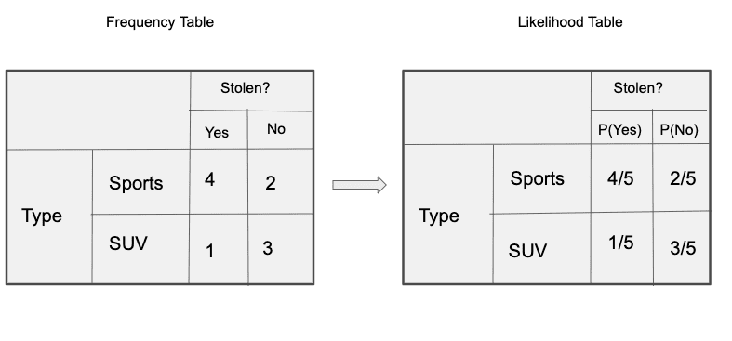
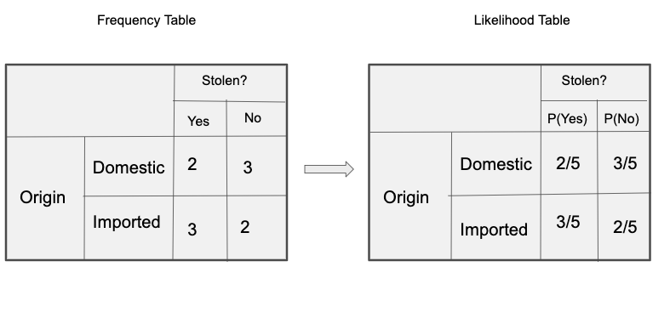
Frequency and Likelihood tables of ‘Type’
Frequency and Likelihood tables of ‘Origin’

Slide 7



So in our example, we have 3 predictors X.
As per the equations discussed above, we can calculate the posterior probability P(Yes | X) as :
and, P( No | X ):
Since 0.144 > 0.048, Which means given the features RED SUV and Domestic, our example gets classified as ’NO’ the car is not stolen.

Slide 8


The Zero-Frequency Problem
One of the disadvantages of Naïve-Bayes is that if you have no occurrences of a class label and a certain attribute value together then the frequency-based probability estimate will be zero. And this will get a zero when all the probabilities are multiplied.
An approach to overcome this ‘zero-frequency problem’ in a Bayesian environment is to add one to the count for every attribute value-class combination when an attribute value doesn’t occur with every class value.
For example, say your training data looked like this:
𝑃(TimeZone=𝑈𝑆|Spam=𝑦𝑒𝑠)=10/10=1
𝑃(TimeZone=𝐸𝑈|Spam=𝑦𝑒𝑠)=0/10=0
Add one to every value in this table when you’re using it to calculate probabilities:
𝑃(TimeZone=𝑈𝑆|Spam=𝑦𝑒𝑠)=11/12
𝑃(TimeZone=𝐸𝑈|Spam=𝑦𝑒𝑠)=1/12

